Slide 1
Systems Analysis and Design
Program Design
Alan Dennis, Barbara Haley Wixom, and Roberta Roth
10-‹#›

Slide 2
Chapter 10 Outline
Moving from logical to physical process models.
Designing programs.
Structure chart.
Program specification.
10-‹#›

Slide 3
INTRODUCTION
Program design – Analysts determine what programs will be written and create instructions for the programmers.
Various implementation decisions are made about the new system (e.g., what programming language(s) will be used.)
The DFDs created during analysis are modified to show these implementation decisions, resulting in a set of physical data flow diagrams.
The analysts determine how the processes are organized, using a structure chart to depict the decisions.
Detailed instructions called program specifications are developed.
10-‹#›

Slide 4
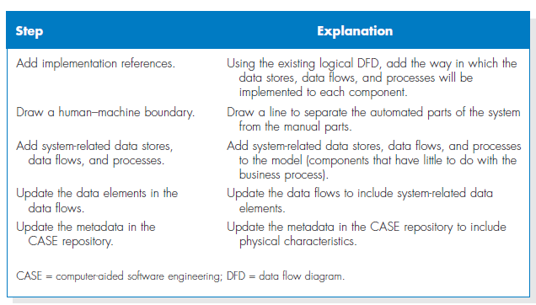
Steps to Create the Physical Data Flow Diagram
© Copyright 2011 John Wiley & Sons, Inc.
10-‹#›

Slide 5
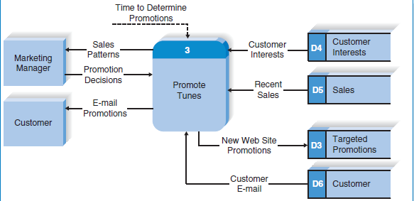
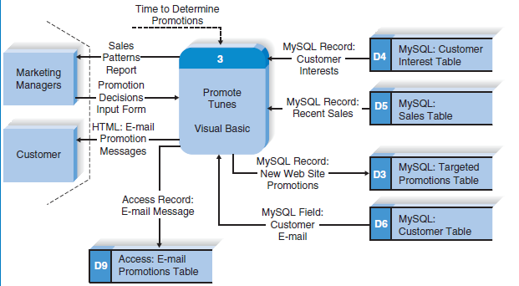
Logical Model of the Promote Tunes Process
Physical Model for Promote Tunes Process

Slide 6
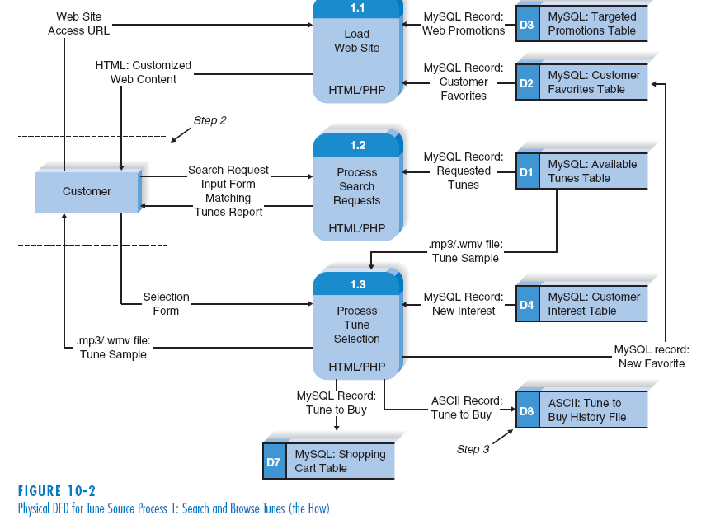
Example of Physical DFD
© Copyright 2011 John Wiley & Sons, Inc.
10-‹#›

Slide 7
STRUCTURE CHART
The structure chart is an Important program design technique that help the analyst design the program.
It shows all components of code in a hierarchical format that implies
Sequence (in what order components are invoked),
Selection (under what condition a module is invoked),
Iteration (how often a component is repeated)
10-‹#›

Slide 8
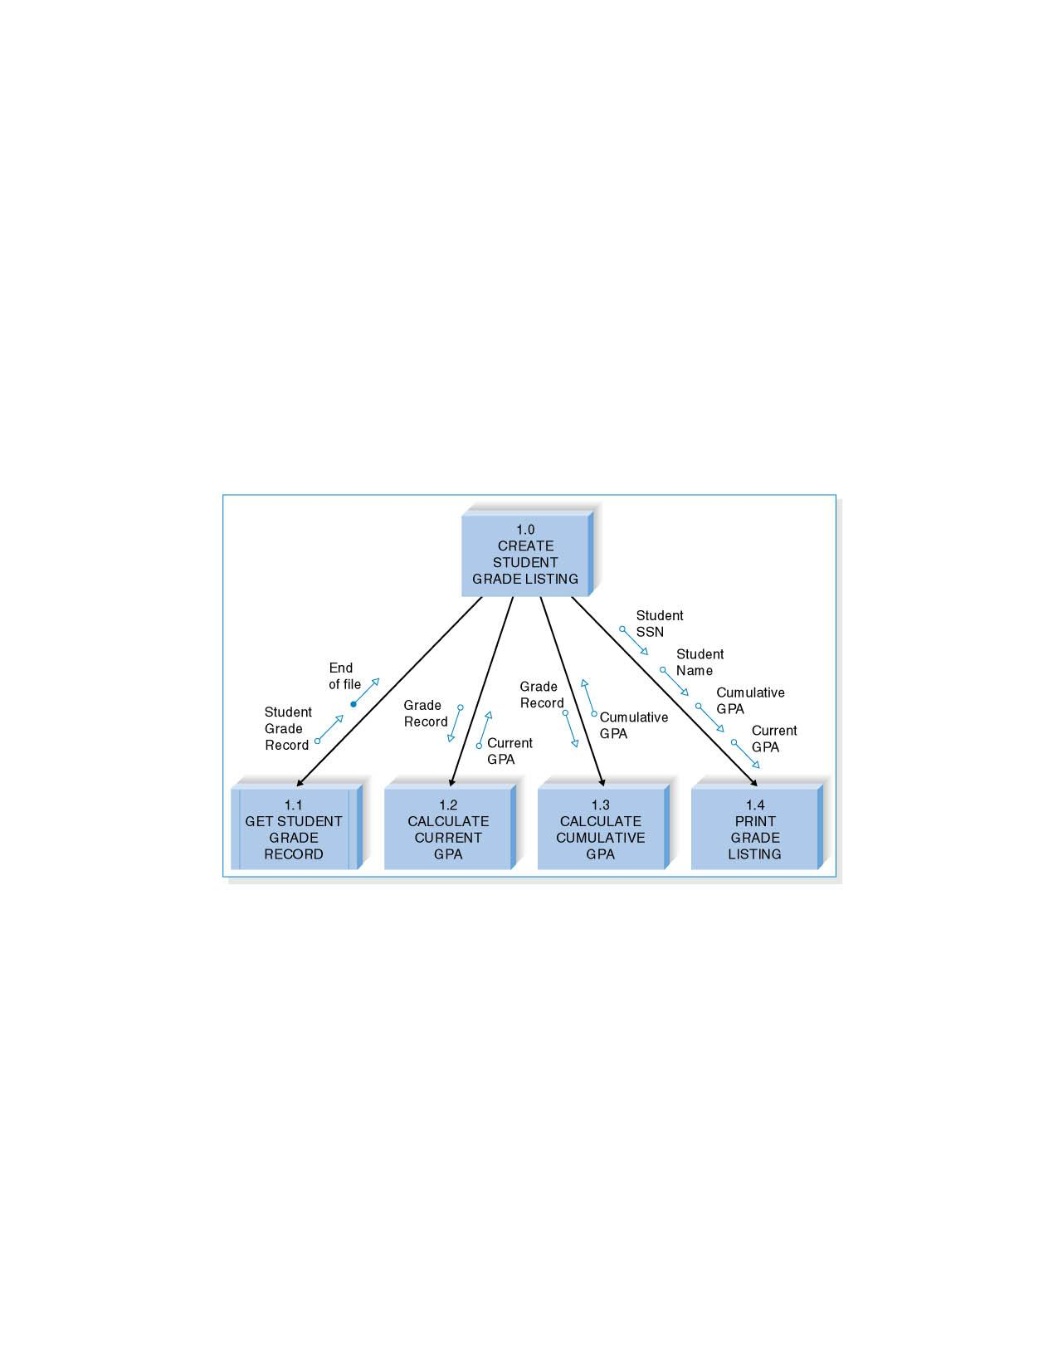
An academic system needs a program that will print a listing of students along with their grade point averages (GPAs), both for the current semester and overall. First, the program must retrieve the student grade records; then it must calculate the current and cumulative GPAs; finally, the grade list can be printed.
10-‹#›
Notes:
a programmer can tell that there are four main
code modules involved in creating a student grade listing: getting the student grade
records, calculating current GPA, calculating cumulative GPA, and printing the listing.
Also, there are various pieces of information that are either required by each
module or created by it (e.g., the grade record, the cumulative GPA).
‹#›

Slide 9
a programmer can tell that there are four main code modules involved in creating a student grade listing: getting the student grade records, calculating current GPA, calculating cumulative GPA, and printing the listing. Also, there are various pieces of information that are either required by each module or created by it (e.g., the grade record, the cumulative GPA).
10-‹#›

Slide 10
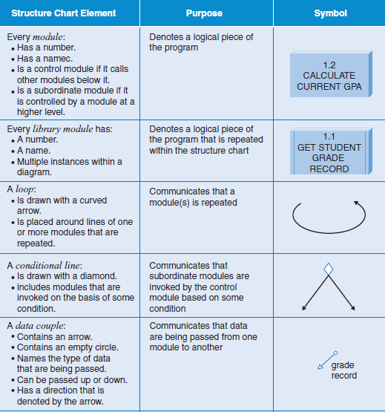
Syntax of Structure Chart
10-‹#›

Slide 11
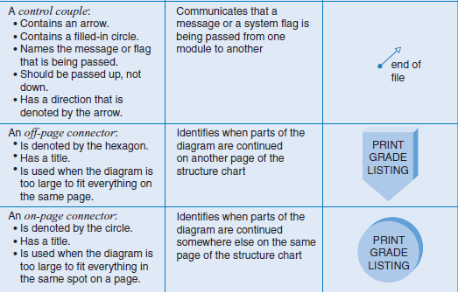
(cont’d)
10-‹#›

Slide 12
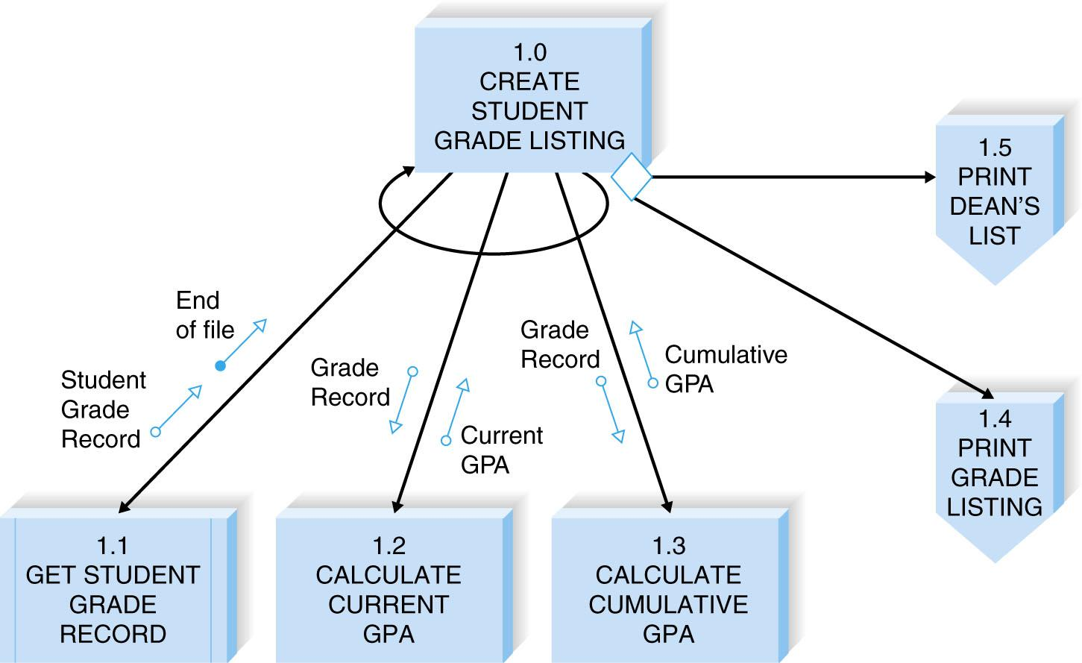
(cont’d)
Revised structure chart example
10-‹#›

Slide 13
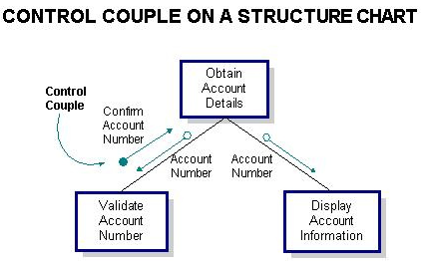
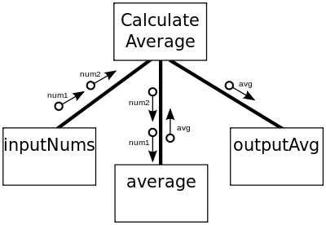
10-‹#›

Slide 14
Design Guidelines
High quality structure charts result in programs that are modular, reusable, and easy to implement.
Measures of good design include
cohesion,
appropriate levels of fan-in and fan-out.
10-‹#›

Slide 15
Build Modules with High Cohesion
Cohesion refers to how well the lines of code within each module relate to each other.
Cohesive modules are easy to understand and build because their code performs one function effectively.
High cohesion = easier to maintain, understand, and reuse.
Low cohesion = hard to manage and test
10-‹#›

Slide 16
Types of Cohesion Overview
Coincidental Cohesion
Logical Cohesion
Temporal Cohesion
Procedural Cohesion
Communicational Cohesion
Sequential Cohesion
Functional Cohesion
(Ordered from worst to best)

Slide 17
Coincidental Cohesion
Definition: Random tasks grouped together.
Example:
def random_tasks():
open_file()
send_email()
draw_circle()

Slide 18
Logical Cohesion
Tasks grouped by category but selected via flags.
Example:
def handle_input(input_type, data):
if input_type == 'keyboard':
process_keyboard(data)
elif input_type == 'mouse':
process_mouse(data)

Slide 19
Temporal Cohesion
Tasks executed at the same time.
Example:
def initialize_system():
load_config()
connect_database()
setup_logging()

Slide 20
Procedural Cohesion
Tasks done in a sequence.
Example:
def process_file():
open_file()
read_file()
close_file()

Slide 21
Communicational Cohesion
Tasks operate on the same data.
Example:
def generate_report(data):
summary = calculate_summary(data)
chart = create_chart(data)
print_report(summary, chart)

Slide 22
Sequential Cohesion
Output of one step is input to the next.
Example:
def process_jpg(jpg):
loaded_jpg = load_jpg(jpg)
resized_jpg = resize_jpg(loaded_jpg)
upload_jpg (resized_jpg)

Slide 23
Functional Cohesion (Best)
Every part contributes to one task.
Example:
def calculate_average(numbers):
total = sum(numbers)
return total / len(numbers)

Slide 24
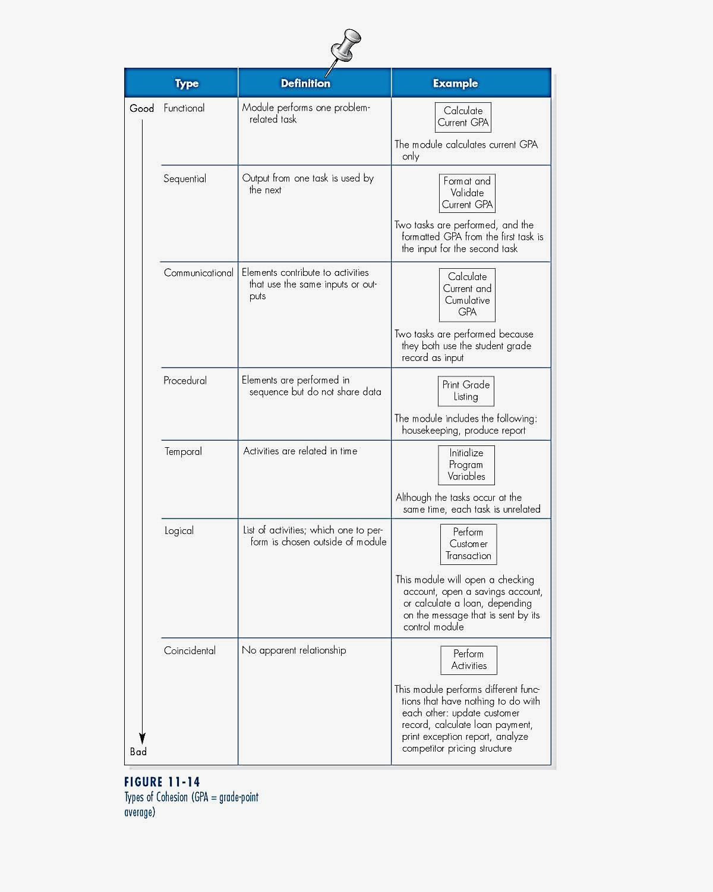
(cont’d)
© Copyright 2011 John Wiley & Sons, Inc.
10-‹#›

Slide 25
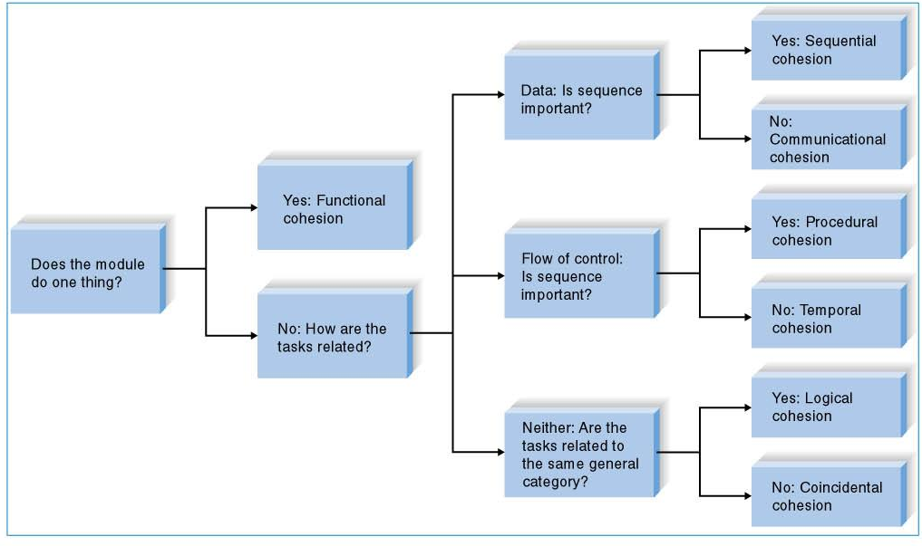
Cohesion Decision Tree
© Copyright 2011 John Wiley & Sons, Inc.
10-‹#›

Slide 26
Fan-In
Fan-in describes the number of control modules that communicate with a subordinate.
A module with high fan-in has many different control modules that call it. This is a good situation because high fan-in indicates that a module is reused in many places on the structure chart.
10-‹#›

Slide 27
Fan-Out
A large number of subordinates associated with a single control should be avoided.
The general rule of thumb is to limit a control module subordinates to approximately seven for low fan-out.
fanin is call by other modules.
Create High Fan-In
fanout is call from that module.
Avoid High Fan-Out
10-‹#›

Slide 28
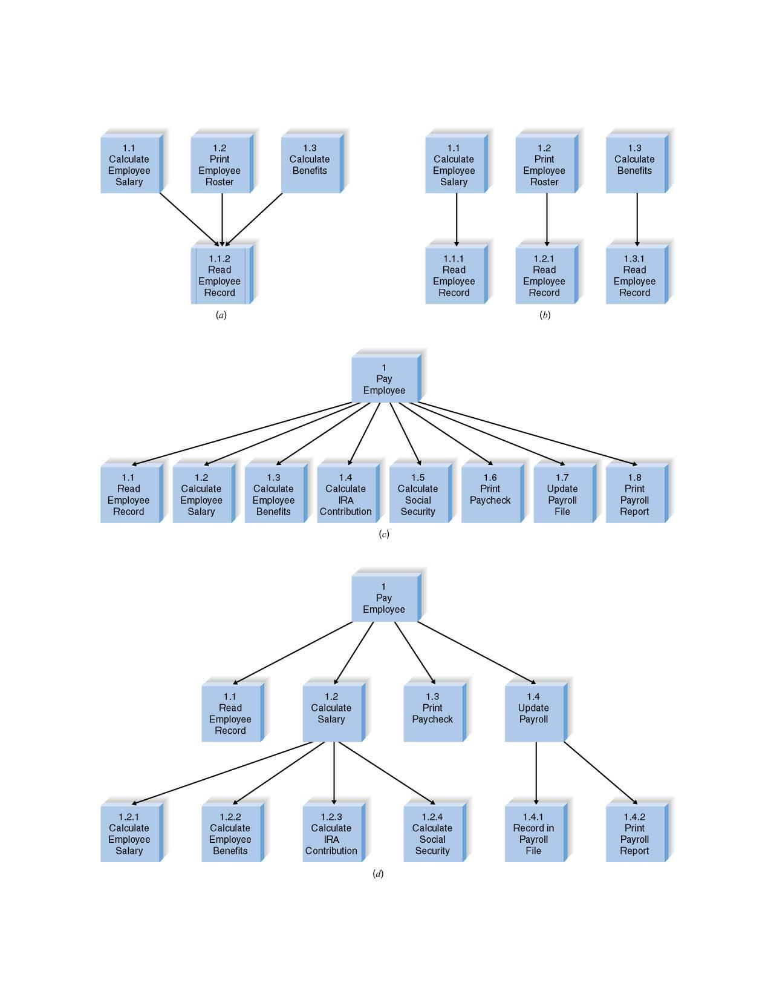
Examples of Fan-in and Fan-out
10-‹#›

Slide 29
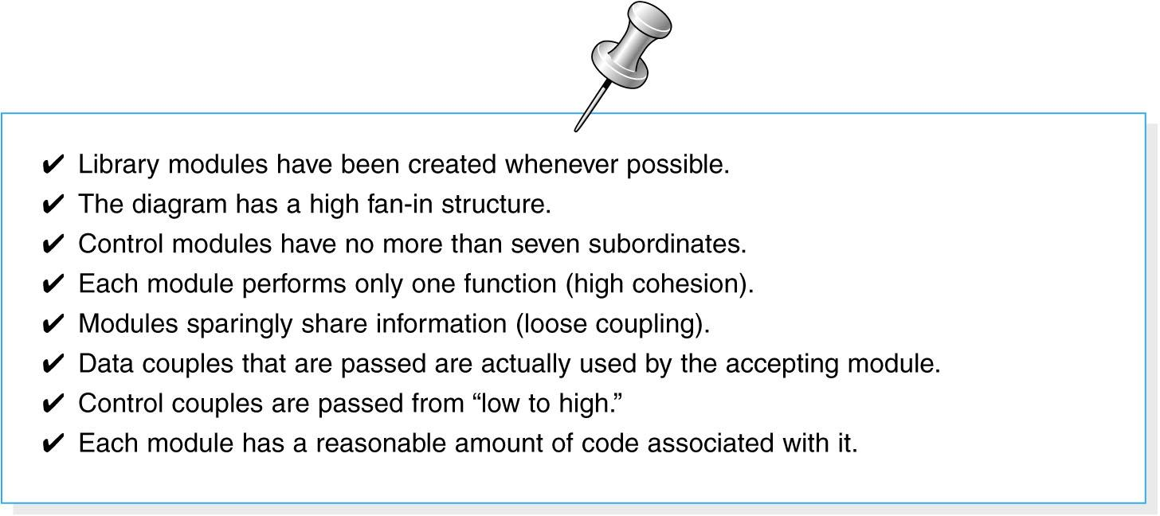
Assess the Chart for Quality
Check list for structure chart quality
10-‹#›

Slide 30
PROGRAM SPECIFICATION
Program Specifications are documents that include explicit instructions on how to program pieces of code.
There is no formal syntax for program specification.
Four components are essential for program specification:
- Program information;
- Events;
- Inputs and outputs; and
- Pseudocode – a detailed outline of lines of code that need to be written.
Additional notes and comments can also be included.
10-‹#›

Slide 31
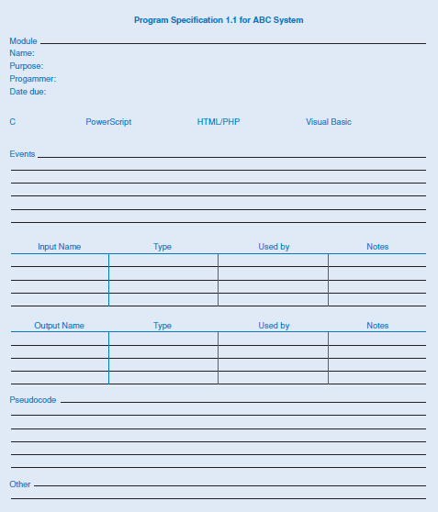
Program specification form
© Copyright 2011 John Wiley & Sons, Inc.
10-‹#›

Slide 32
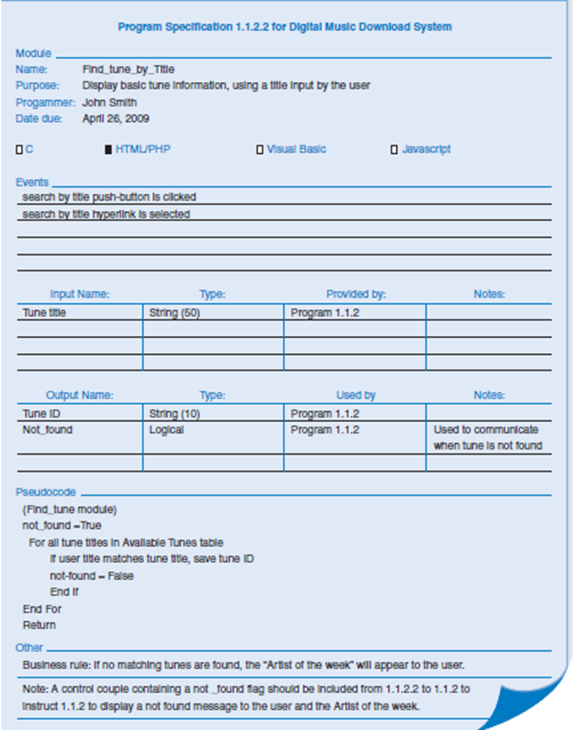
10-‹#›

Slide 33
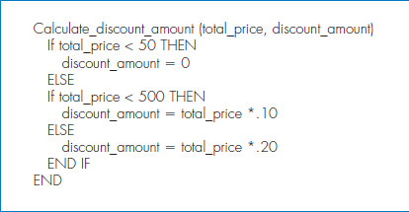
(cont’d)
Pseudocode Example
10-‹#›

Slide 34
SUMMARY
Moving from logical to physical process models.
- Physical DFDs show implementation details.
Structure chart.
- The structure chart shows all of the functional components needed in the program at a high level.
Building structure chart.
- Module, control connection, couples, review.
Structure chart design guidelines.
- Cohesion, coupling, and fan-in/fan-out.
Program specifications.
- Program specifications provide more detailed instructions to the programmers.
10-‹#›

